Slide 1



Hi everyone!
Welcome to my Final project presentation at

Slide 2

My name is Nail.
Today I’ll present my
Rent a car website.

Slide 3


Technologies used in the Project
Front-end
SASS
HTML
JS
Tilt JS
Scroll Reveal
Base 64 for upload image

Slide 4
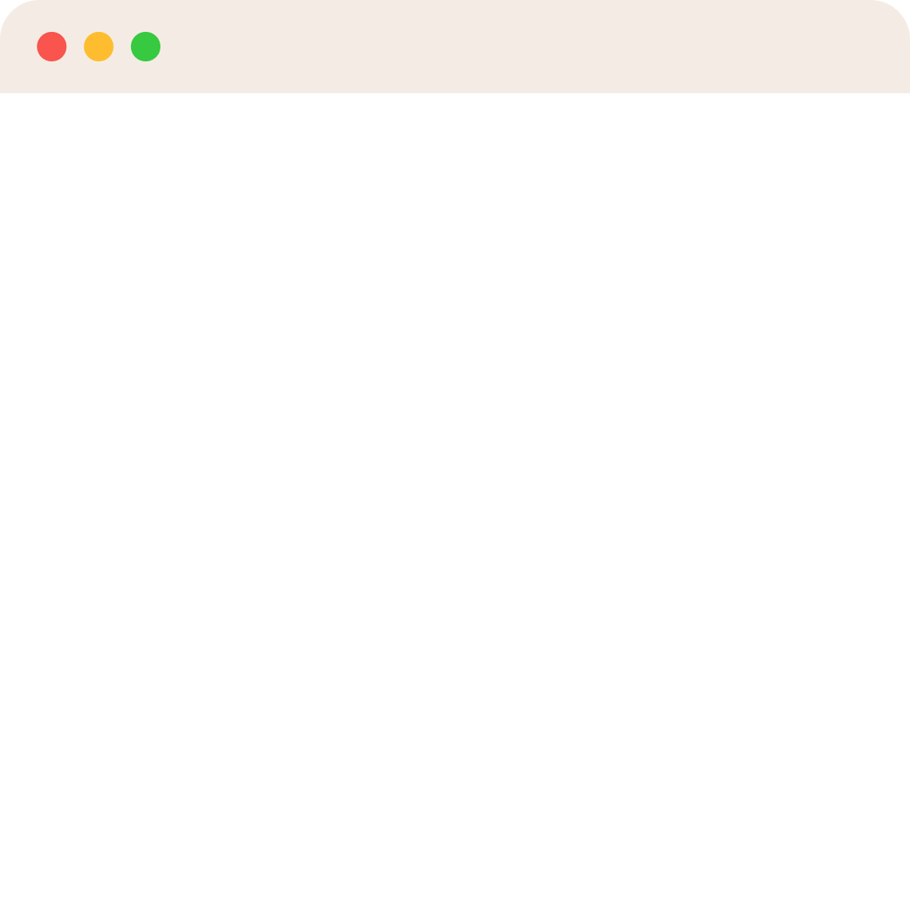

Web application functionality
User Functionality
Sign up , sign in
Add favorite , delete favorite
Add car
Filtering cars price or make
Search cars
View cars with details
Cars specifications,Rent now button
Admin Functionality
Deleting users
Posting cars and editing
View users request car
Car and user information that users want to rent

Slide 5

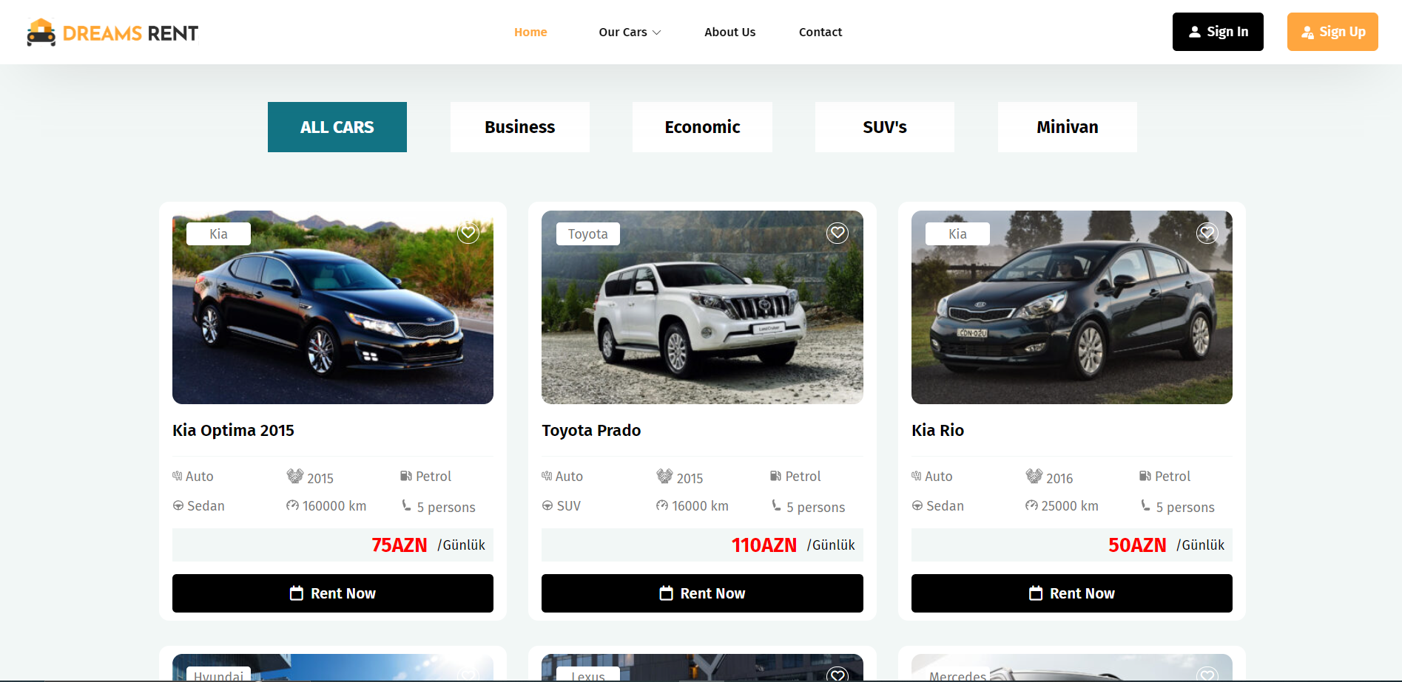
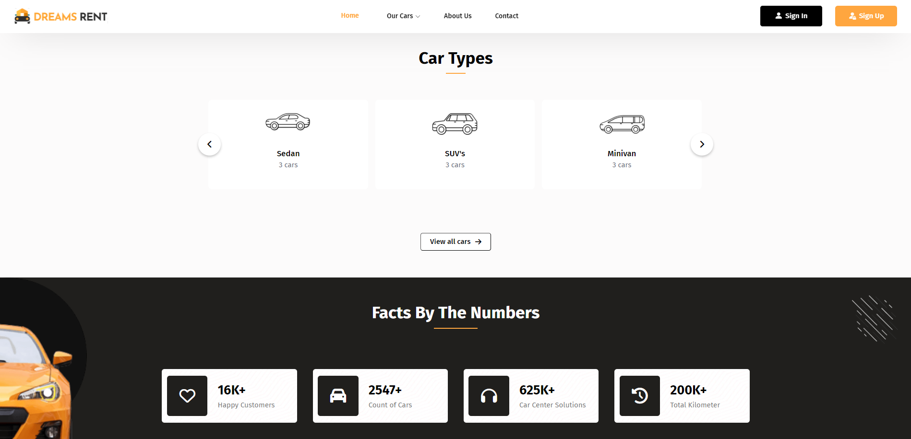

Website pages

Slide 6
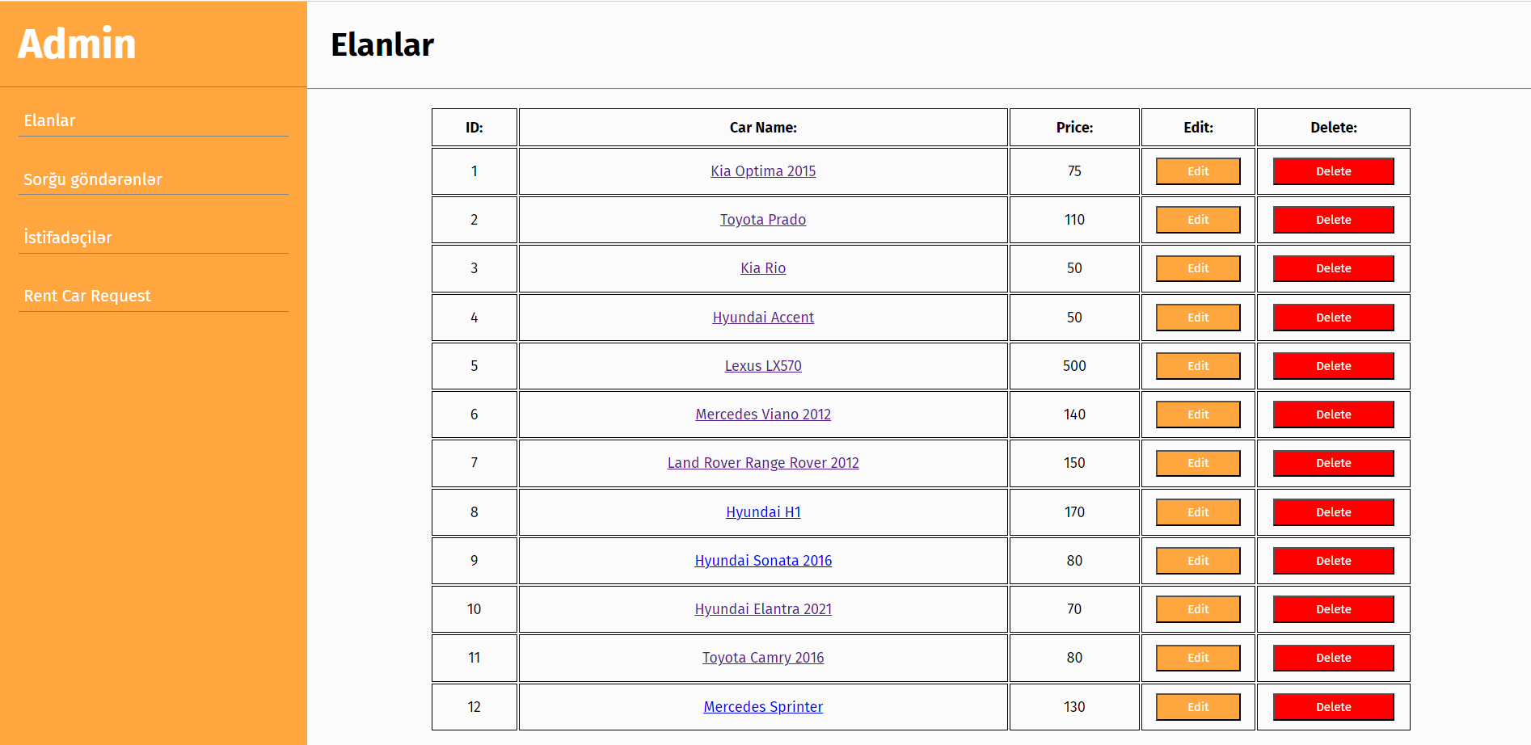
Admin Dashboard

Slide 7
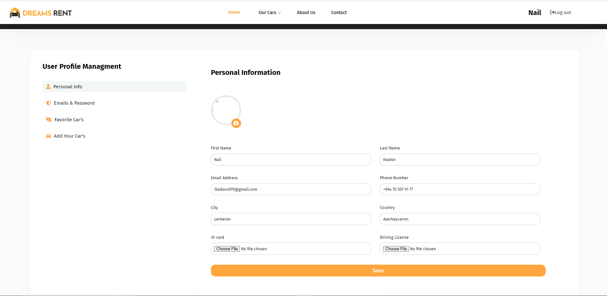
Profile Page

Slide 8
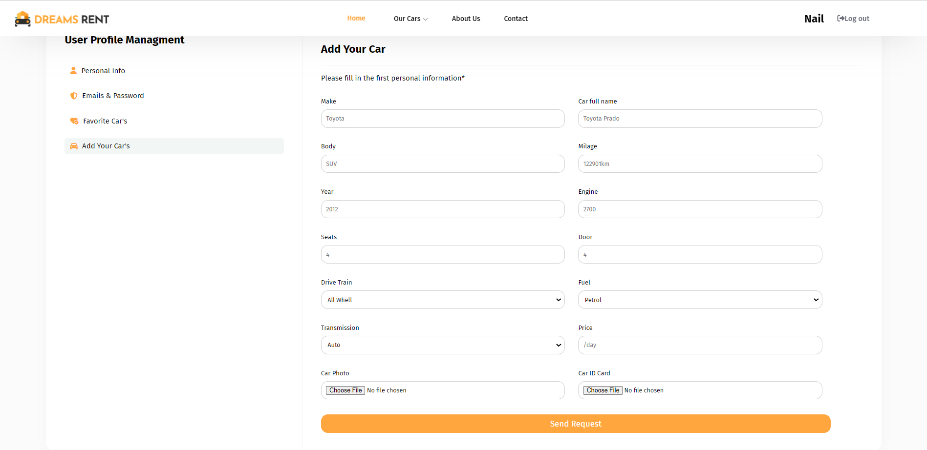
Profile Page

Slide 9
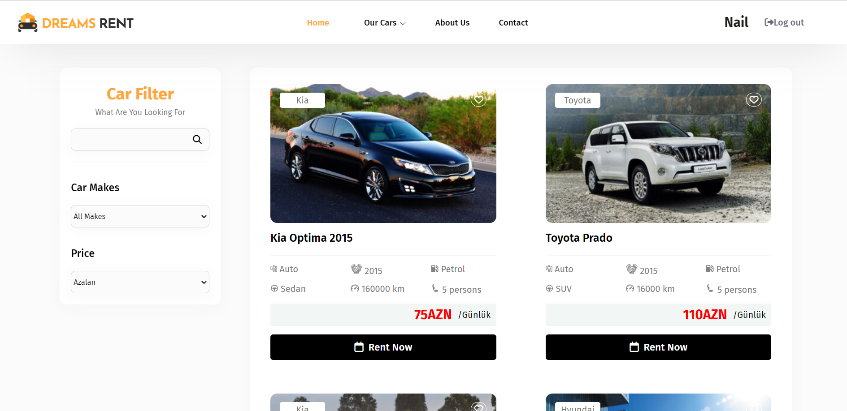
Website Page

Slide 10
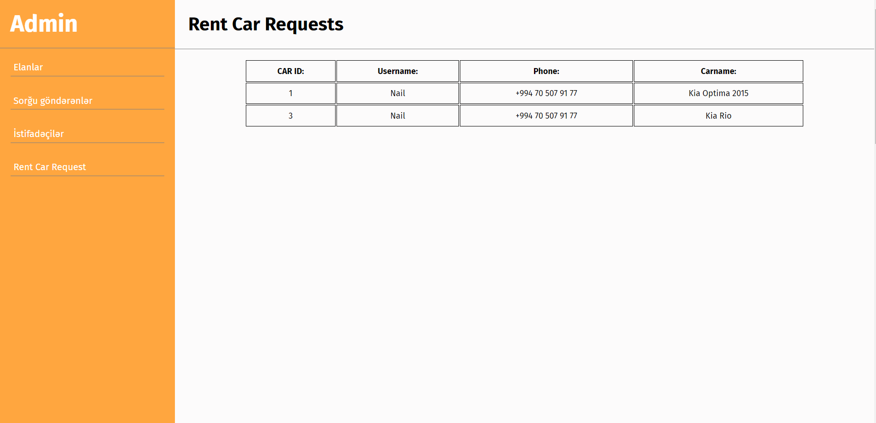
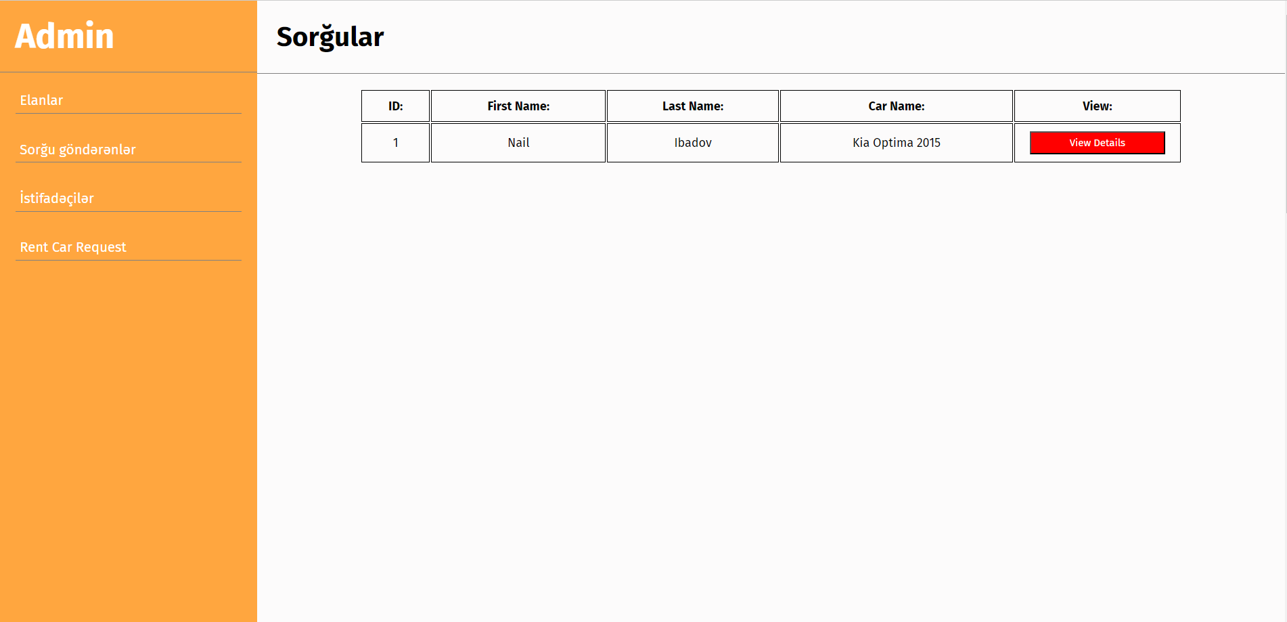
Admin Dashboard

Slide 11
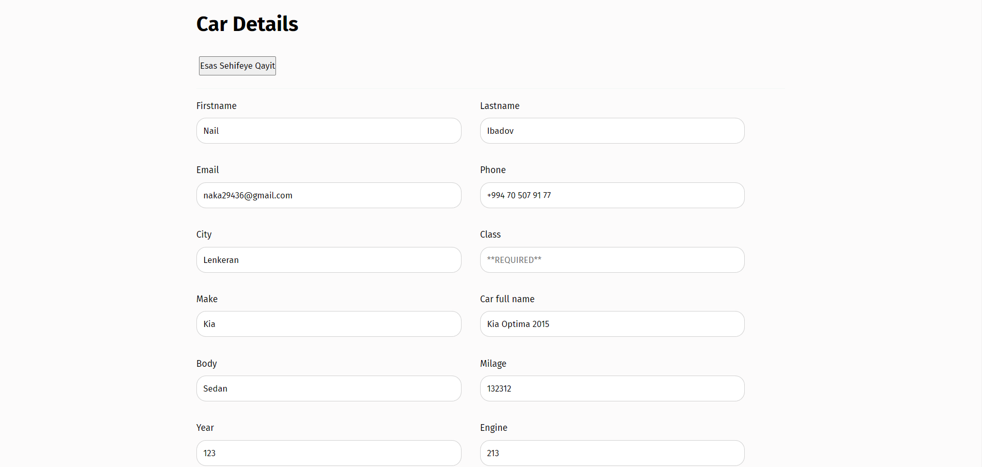
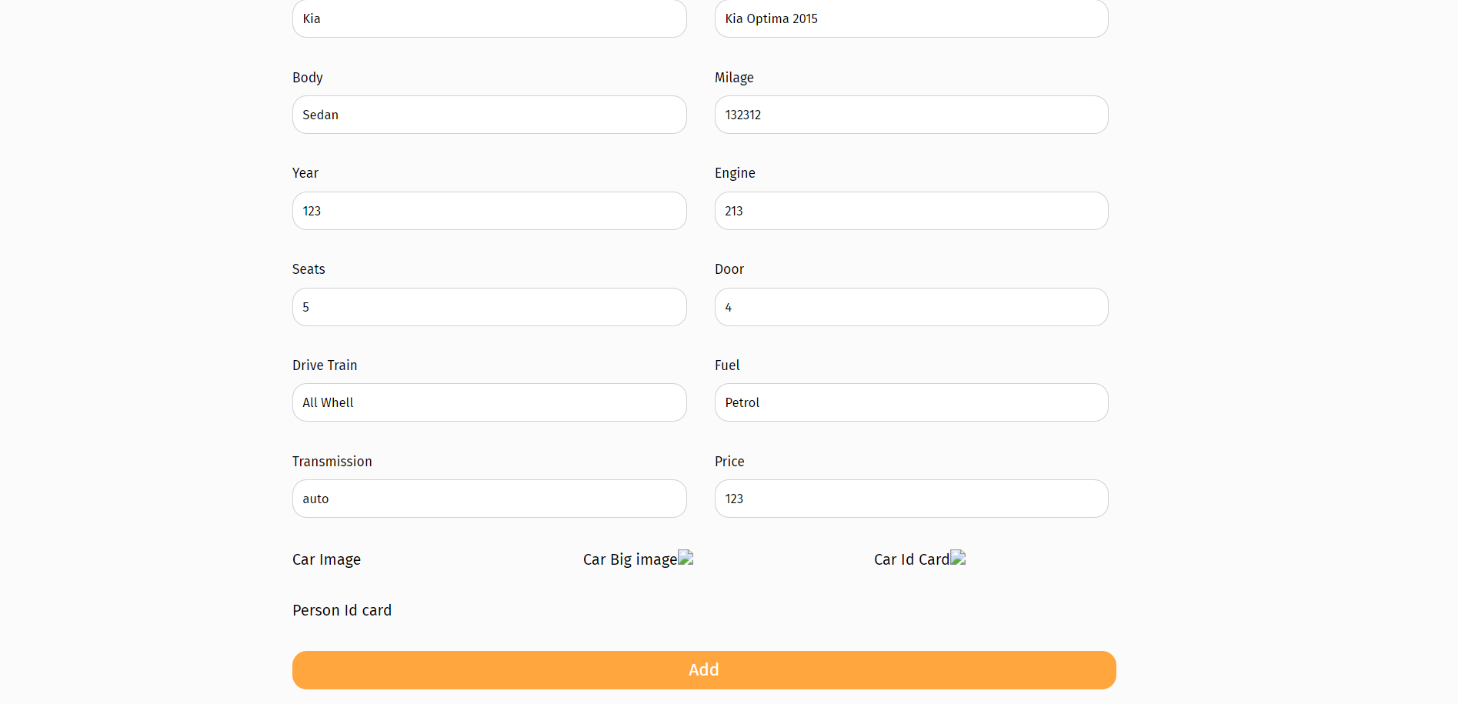
Admin Dashboard

Slide 12

Thank you for Attention!

